Slide 1
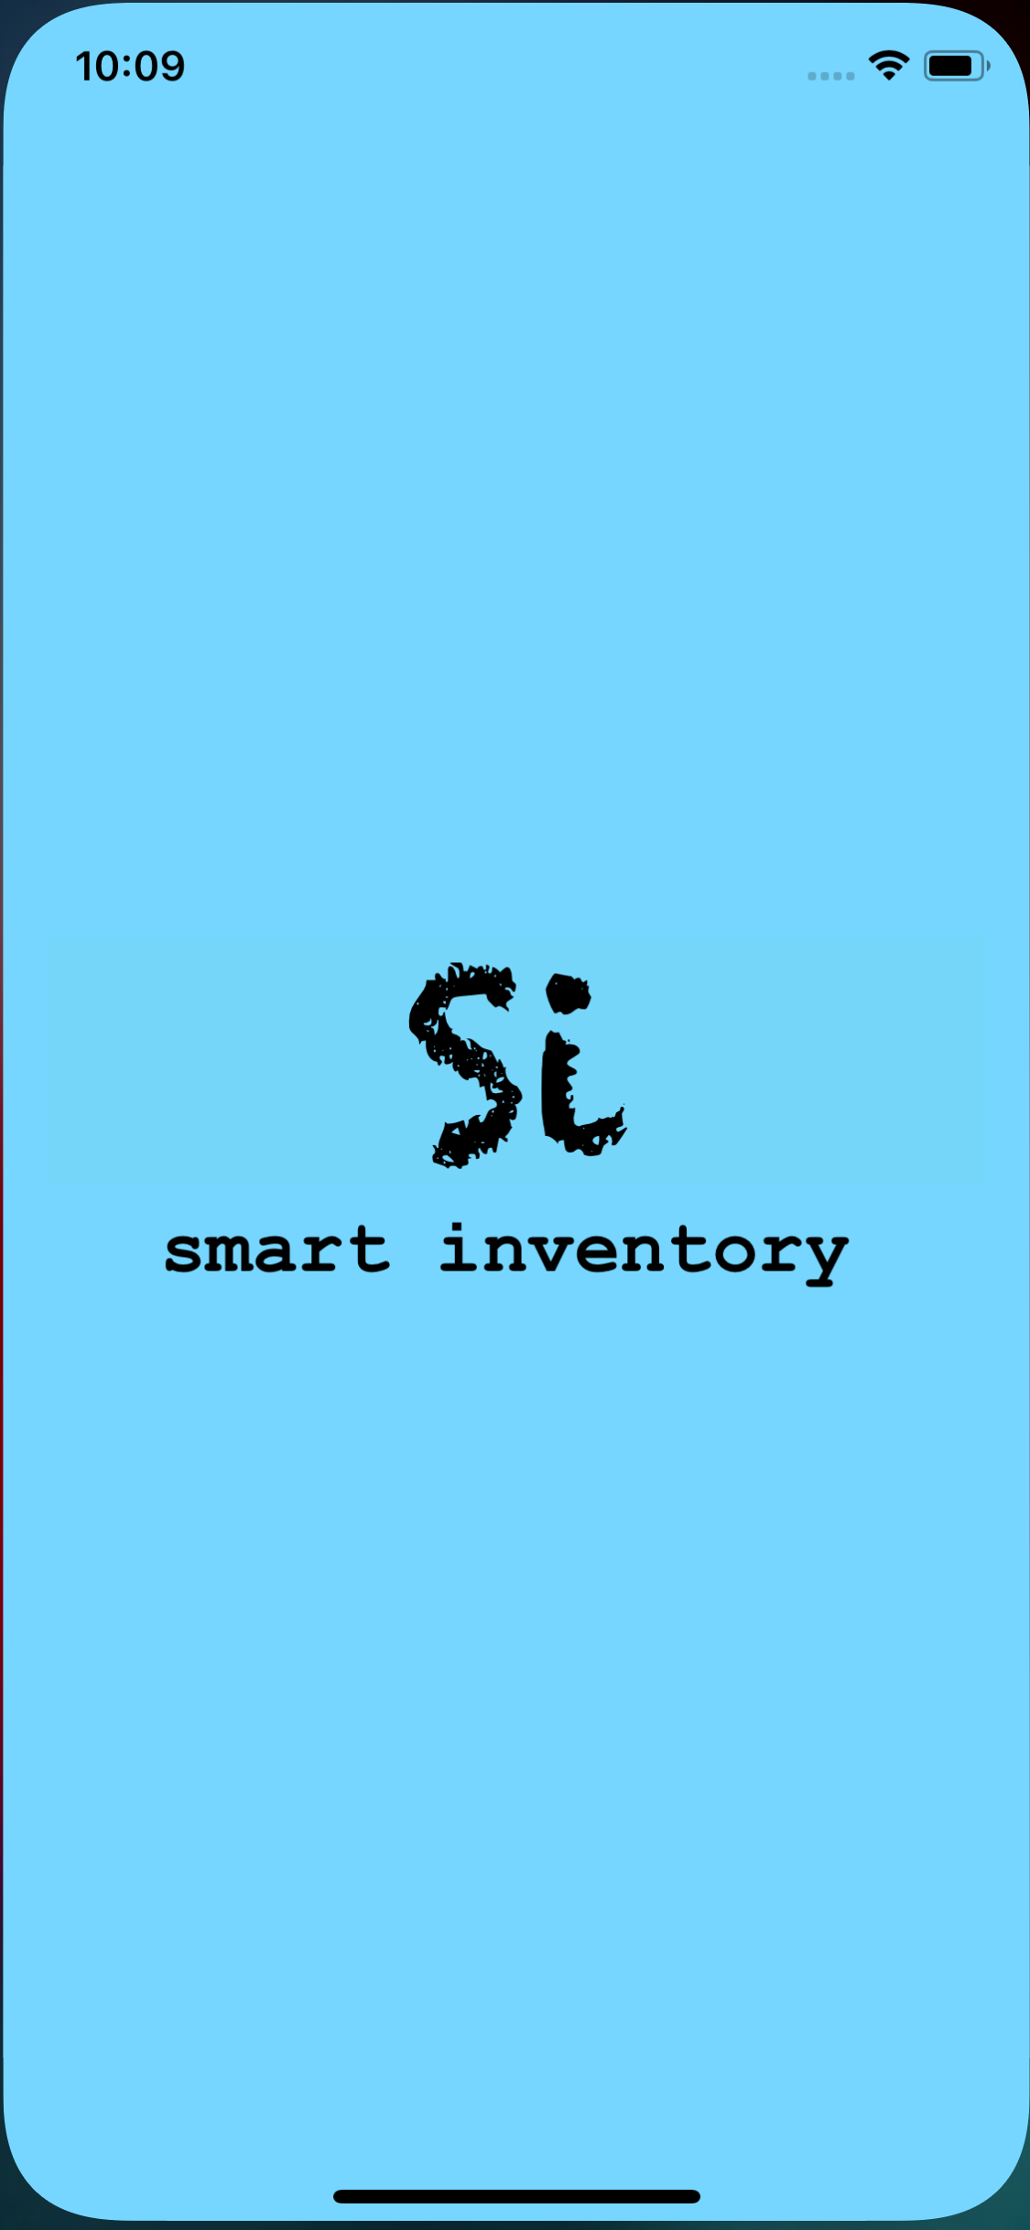
Smart Inventory
Mobile Application - IOS

Slide 2







Team Members
Dr. Zhengrui Qin
Bharadwaj Dasari
Shruthi Patlolla
Sai Mohan Vummidi
Manogna Sivangula
Midhun Kumar Kurapati
Vamshi Raj Jennaikode

Slide 3
Contents
Introduction
Recap
Features
Scope
Requirements
Design
GUI
Backendless mBaas
Tools and Technologies
Demo
Summary
Midhun Kuar Kurapati

Slide 4
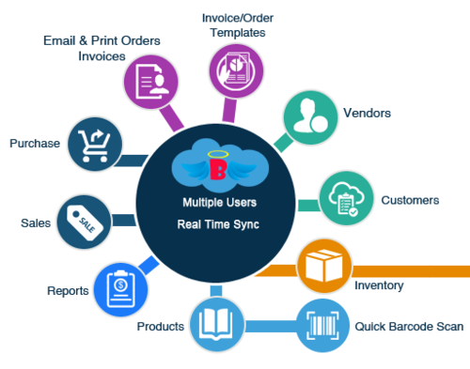
Introduction
The inventory system is a mobile application which helps a store owner to manage his online business.
The Owner and the Seller can communicate through the application.
The application will manages the shipping labels, product details, orders and transaction details.
Midhun Kumar Kurapati

Slide 5
Features
Online availability of the store.
Required products are posted on dashboard.
Messaging system.
Order management.
Generates shipping labels.
Transaction management.
Shipment Tracking.
Midhun Kumar Kurapati

Slide 6
Scope
Stock efficiency
Visibility of supply chain
Cost Maintenance
Quality Management
Time Management
Midhun Kumar Kurapati

Slide 7
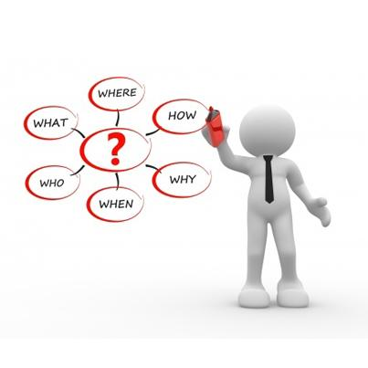
Requirements
External Interface Minimum Requirements
a. Hardware Interfaces
iPhone, iPad, MacBook, IMac
System Memory - 64GB
Processor - 2.3GHz
Software Interfaces
OS X - UNIX
IDE - XCode
IOS Emulator
Midhun Kumar Kurapati

Slide 8
Requirements
Functional Requirements
Admin Modules
Login
Add or Remove Users
Add or Delete Items
Post updates on the dashboard
One to one communication
Send shipping labels to user
Send amount to user
View transaction history
Midhun Kumar Kurapati

Slide 9
Requirements
User Modules
SignUp
Login
View Admin posts
Contact Admin
Request to sell items
Request for shipping labels
Send an invoice for payments
View transaction records
Vendor rating
Midhun Kumar Kurapati

Slide 10
Requirements
Non-Functional Requirements
Performance
Reliability
Availability
Security
Portability
Midhun Kumar Kurapati

Slide 11
Requirements
Logical Database Requirements
Types of information used by various functions
Frequency of use
Integrity constraints
Data entities and their relationships
Midhun Kumar Kurapati

Slide 12
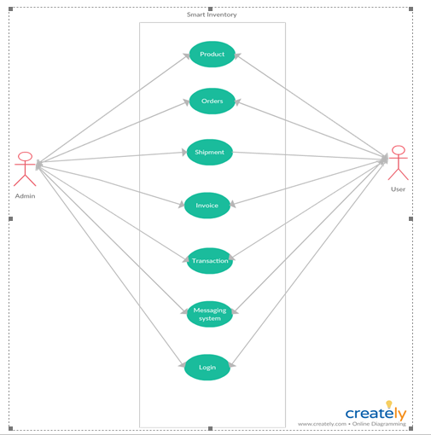
DESIGN
USE CASE DIAGRAM
This diagram describes all the
System / software requirements
For software program.
Specifies behaviour.
Helps to design a system from
End user requirements.
Fig.1: Use Case Diagram
Sai Mohan

Slide 13
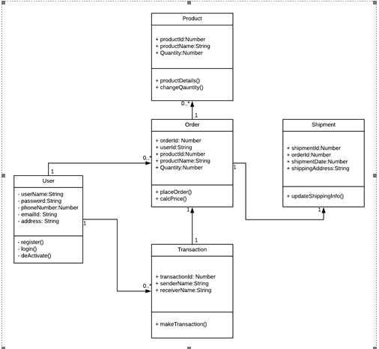
DESIGN
CLASS DIAGRAM
Describes about all the entities and
their attributes.
Product
User
Order
Shipment
Transaction
Fig.2: Class Diagram
Sai Mohan

Slide 14

Sai Mohan

Slide 15
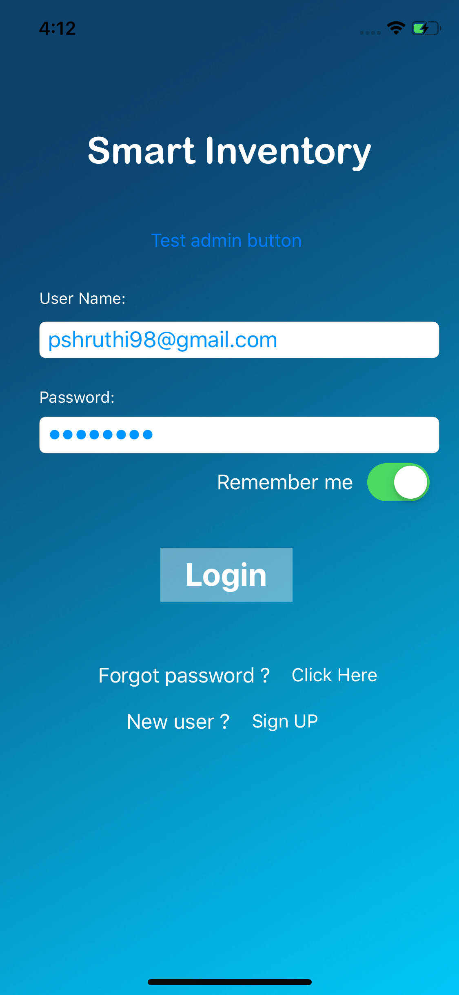
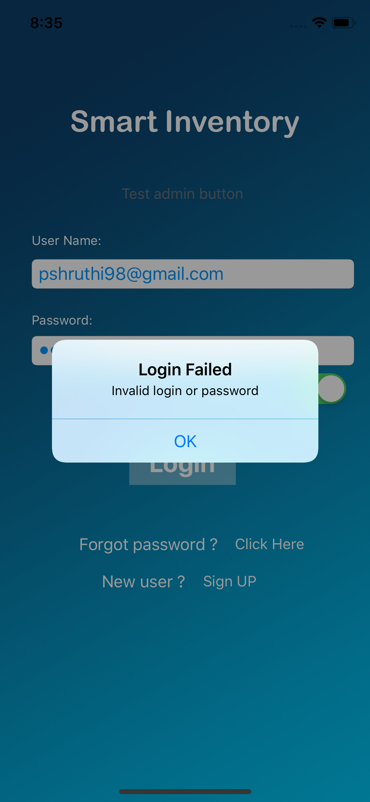
Login screen
Fig.3: Login Screen Fig.4: Login authentication Failed
Sai Mohan

Slide 16
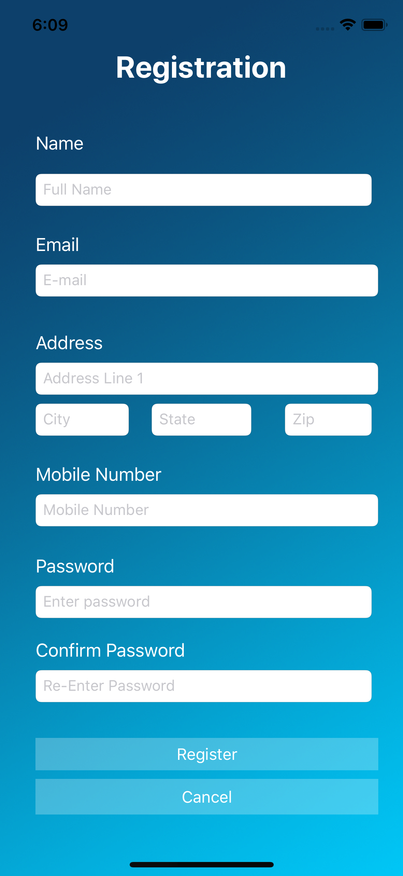
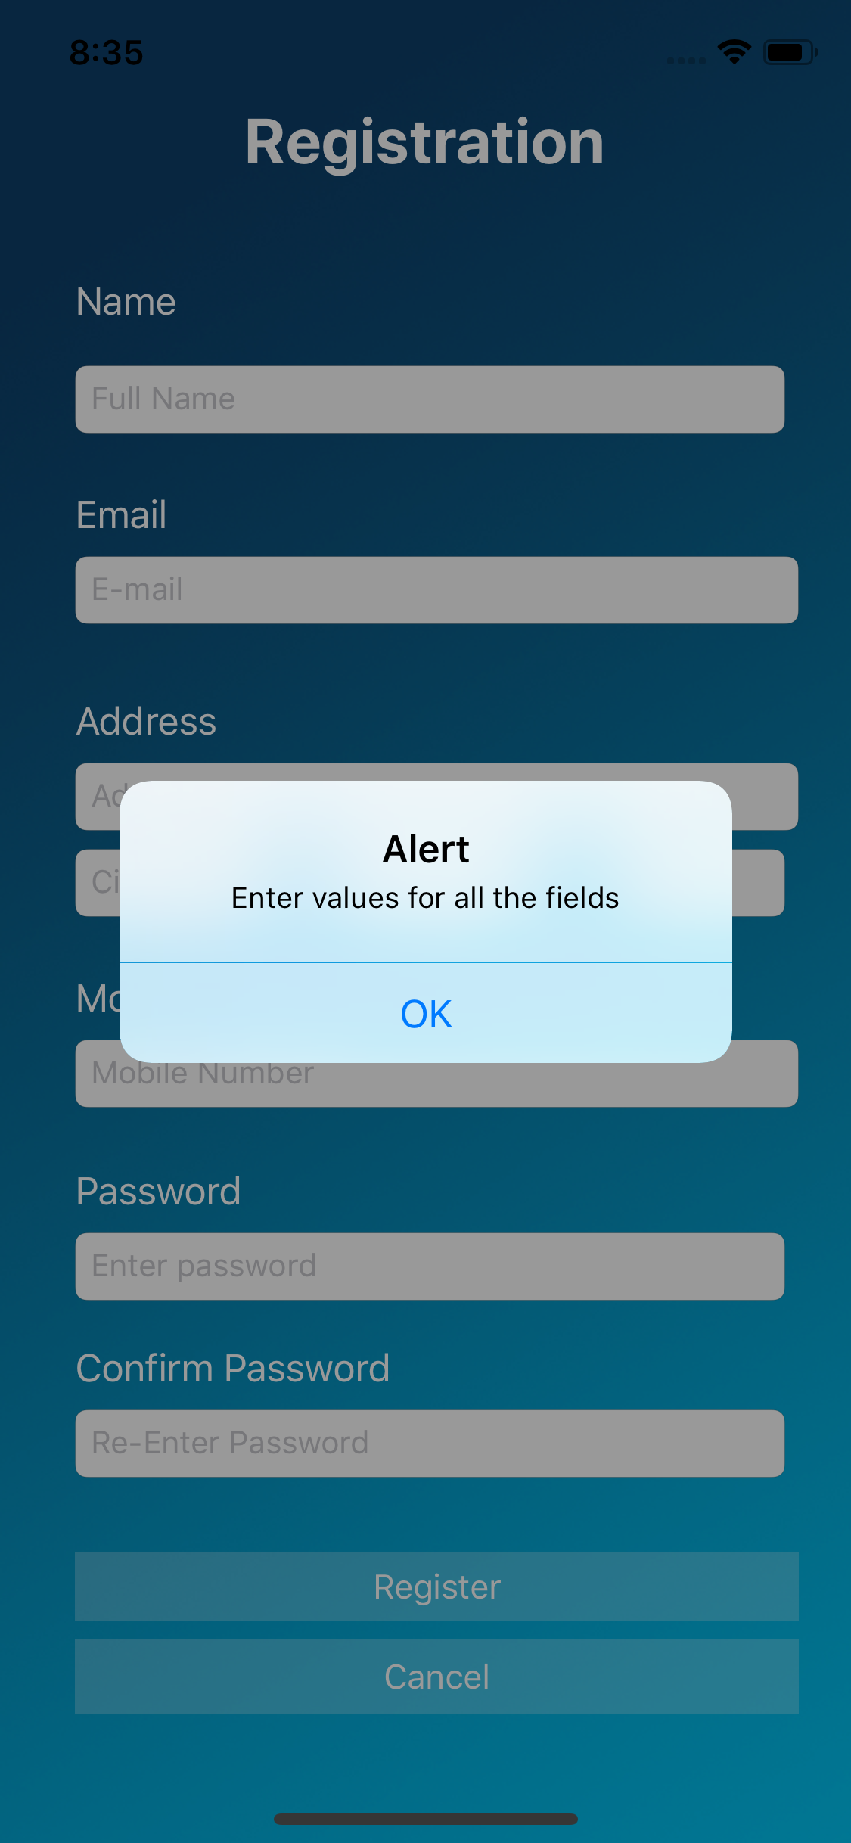
Registration screen
Fig.5: Registration Fig.6: Registration Alert
Sai Mohan

Slide 17
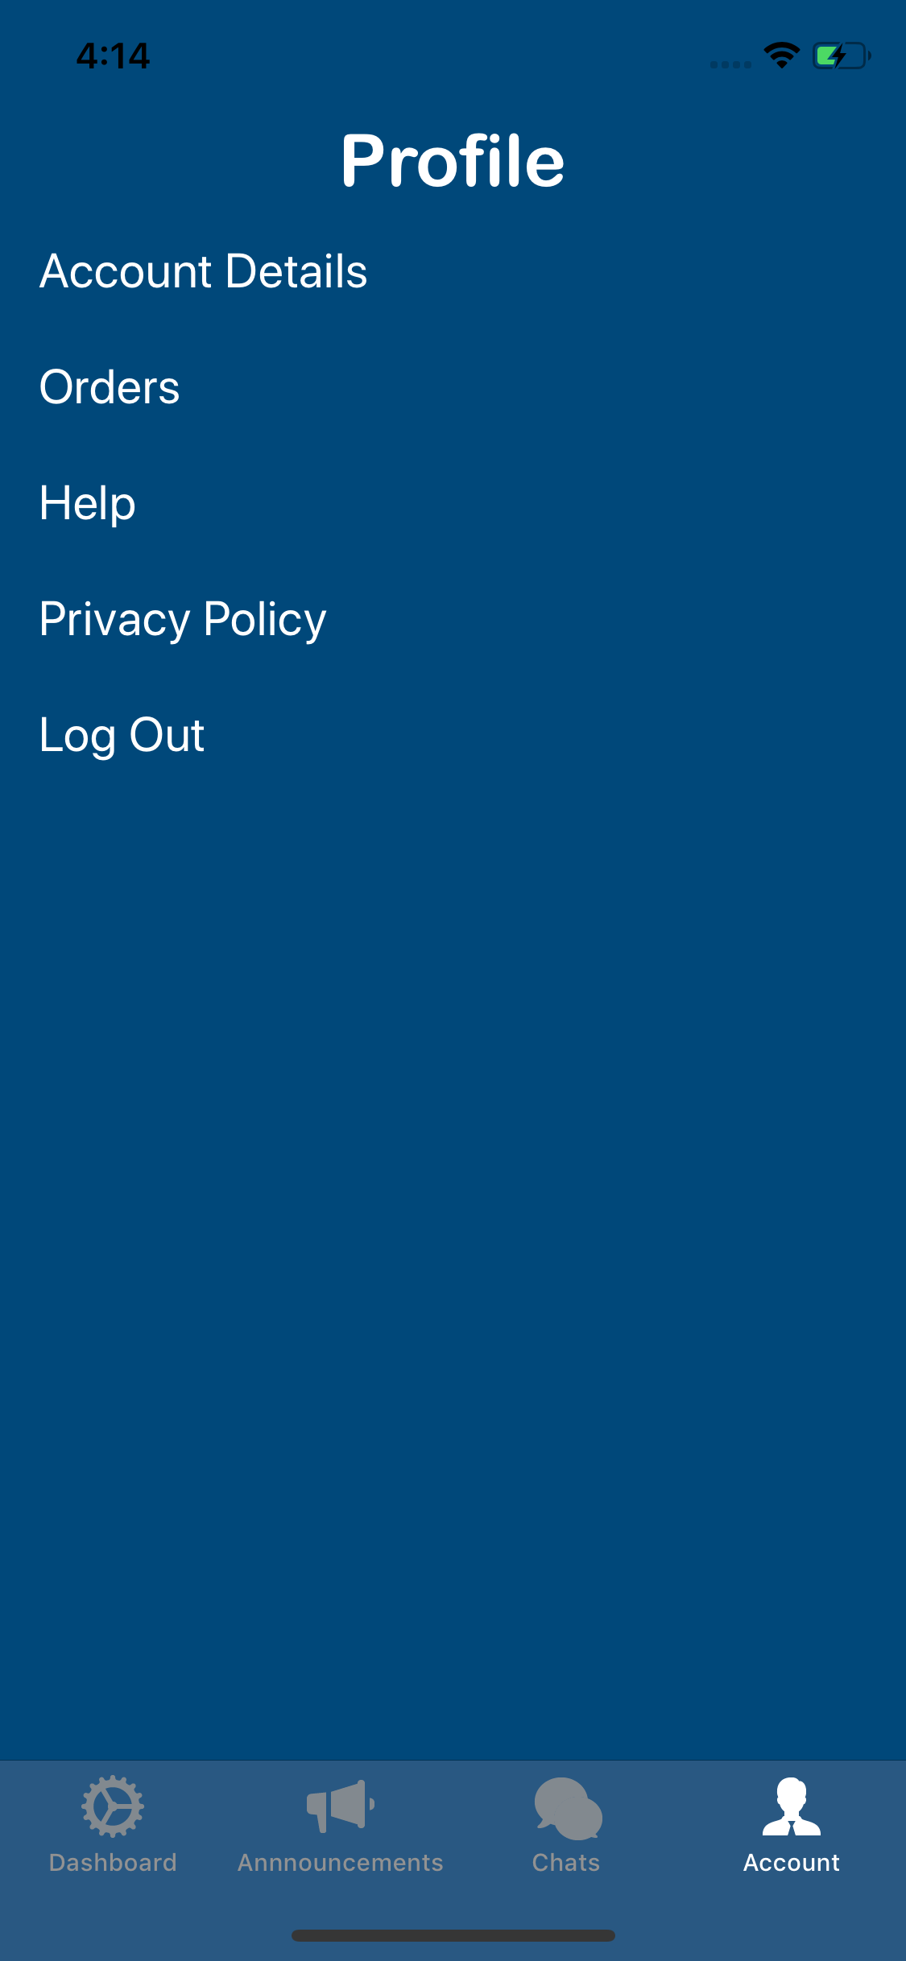
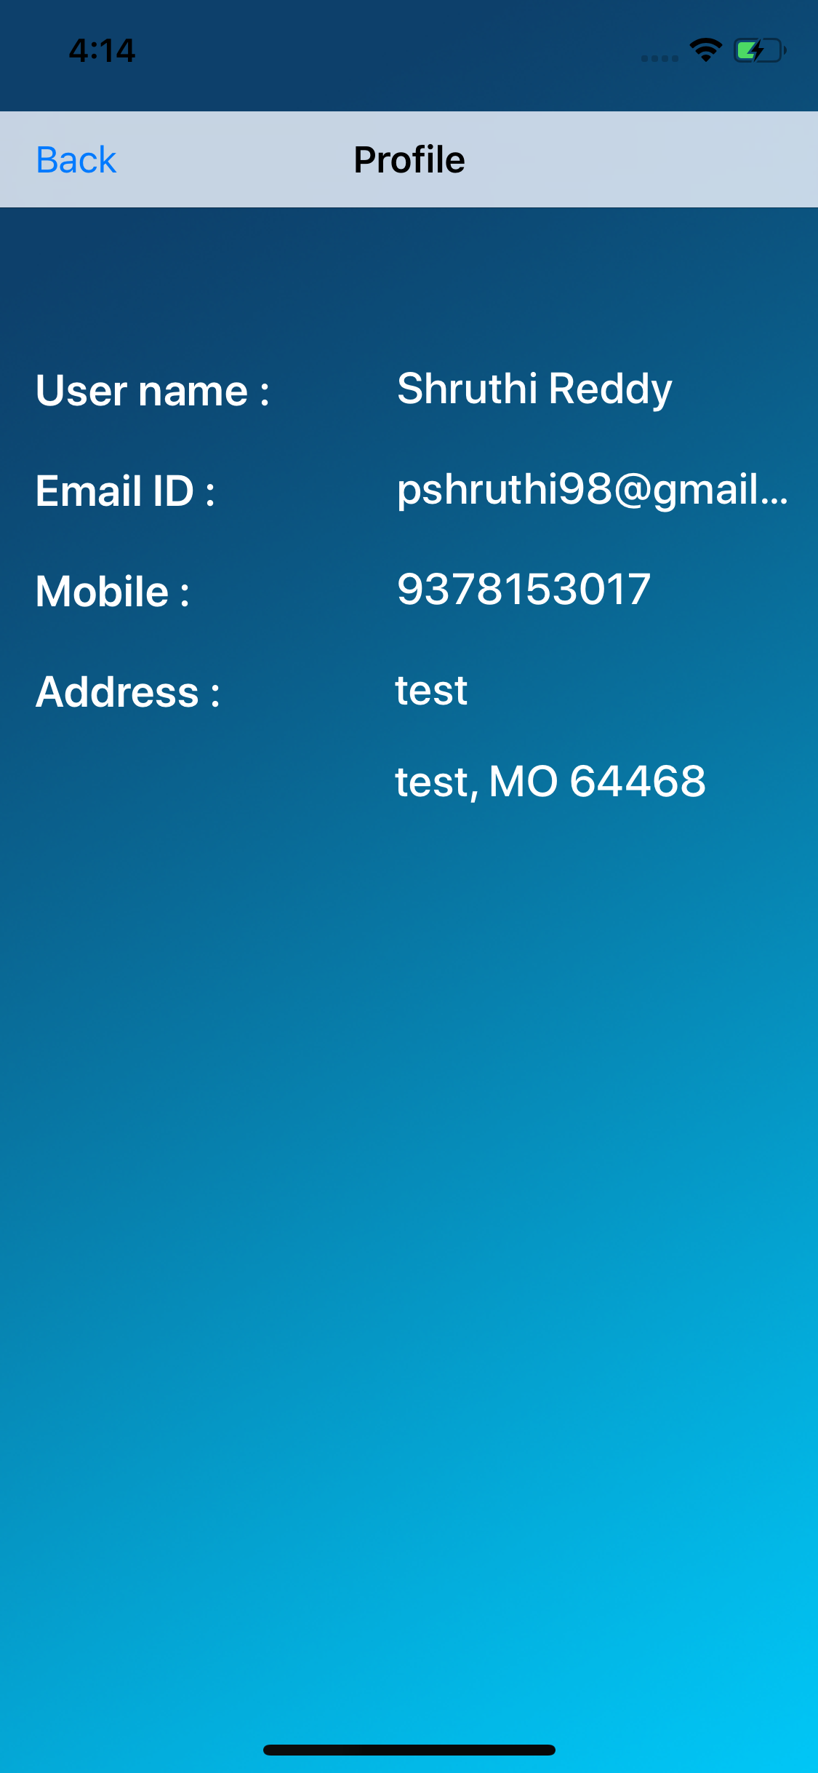
User-Profile screen
Fig.8: Account details
Fig.7: User Profile Page
Sai Mohan

Slide 18
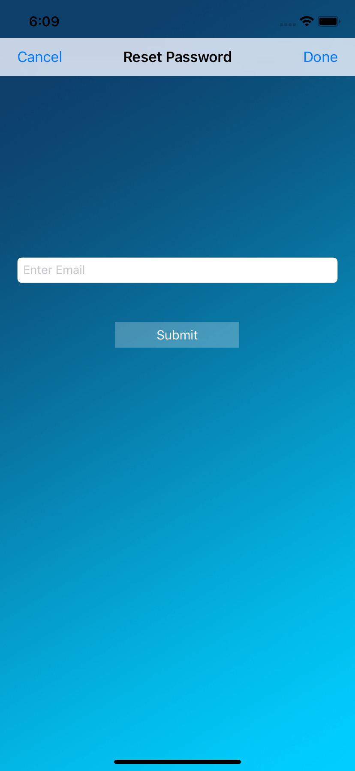
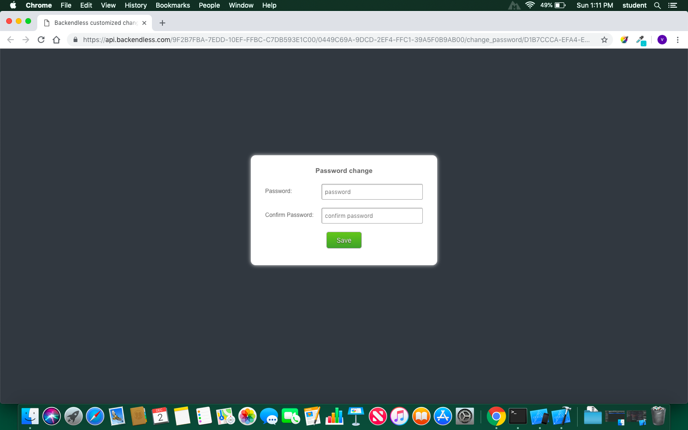
Forgot Password
Three steps to reset password
Needs registered Email
A Link is sent to user’s email
Reset password
Fig.9: Reset password screen 1
Sai Mohan

Slide 19
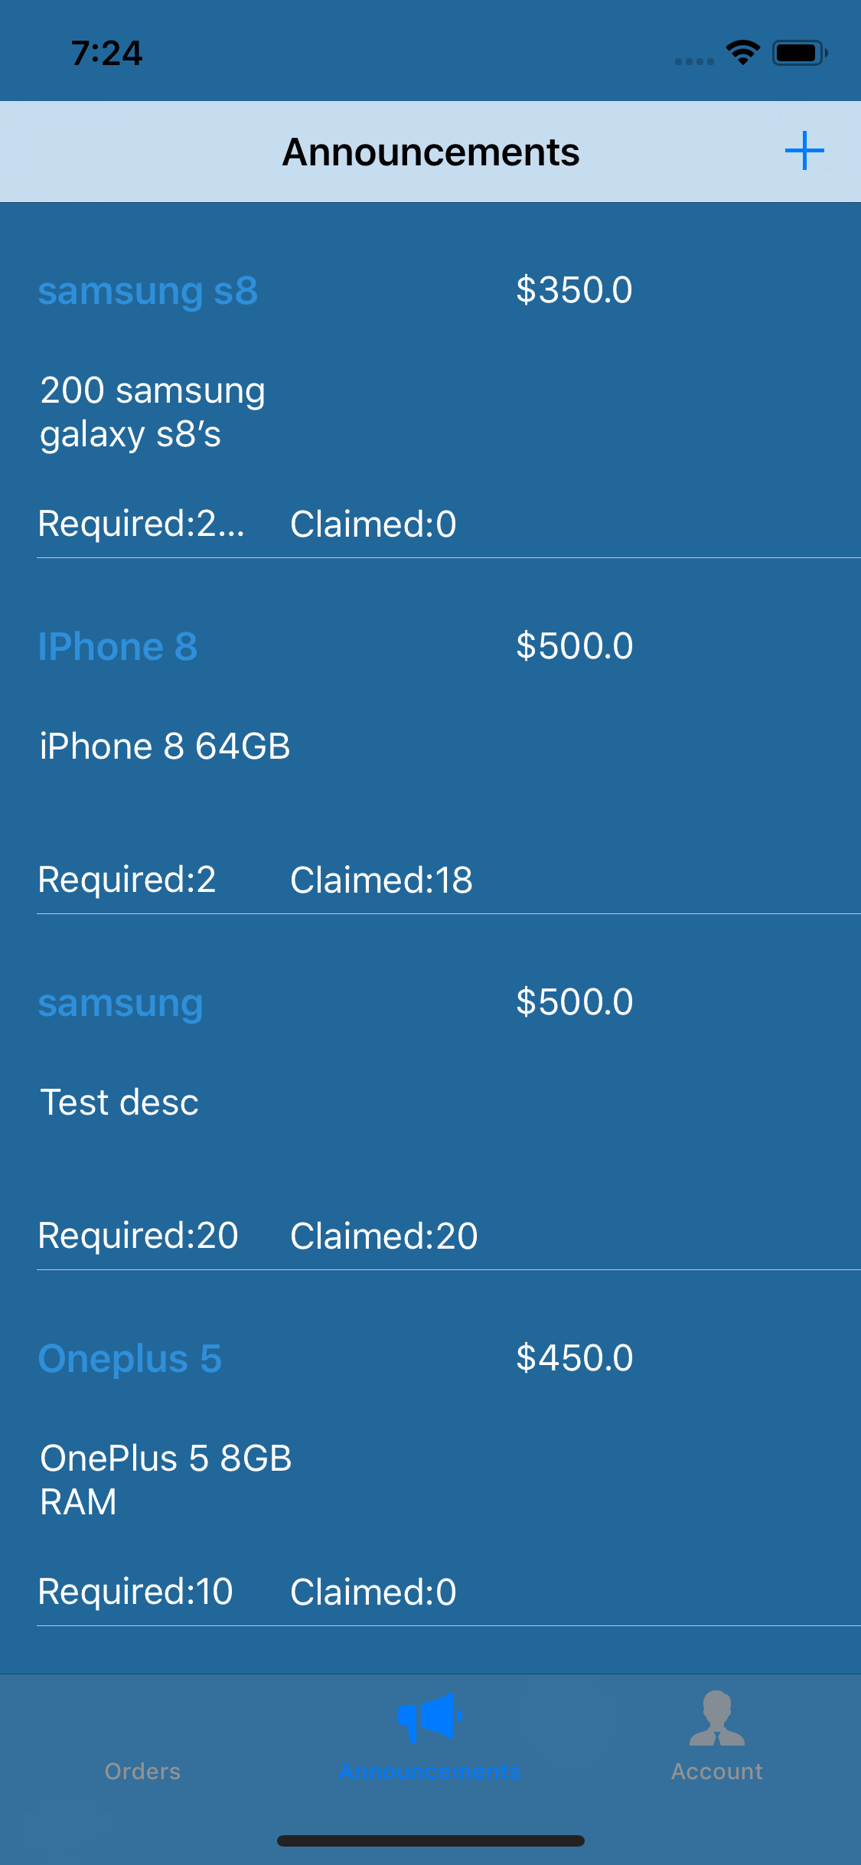
Admin - Announcements
Announcement view for Admin
Consists of list of products announced
‘+’ to post announcement
‘+’ clicked it is redirected to post announcements view.
Can delete the announcement by swiping announcement right side.
Can update announcement by clicking on announcement.
Fig.11: Admin Announcements View
Sai Mohan

Slide 20
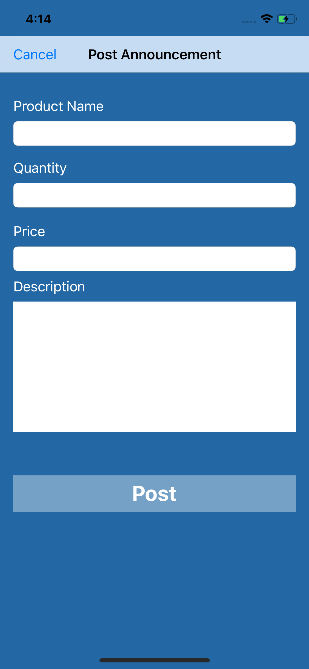
Post Announcements
When you click on post announcement:
A record is created for products table in the back-end
Announced product is displayed in the dashboard of all the users and admin
Fig.12: Post Announcements View
Sai Mohan

Slide 21
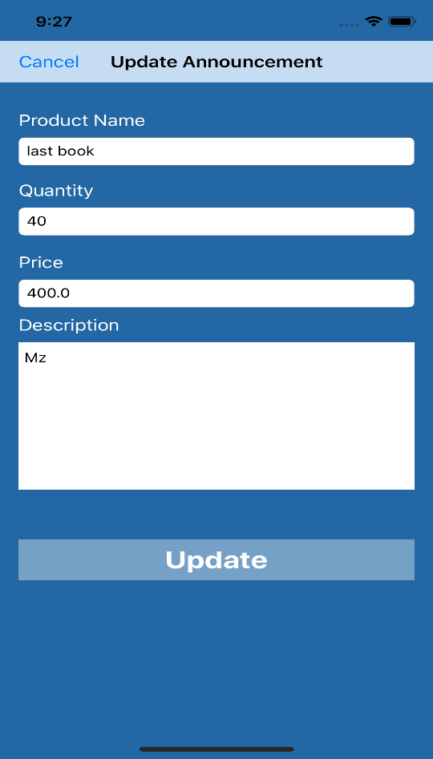
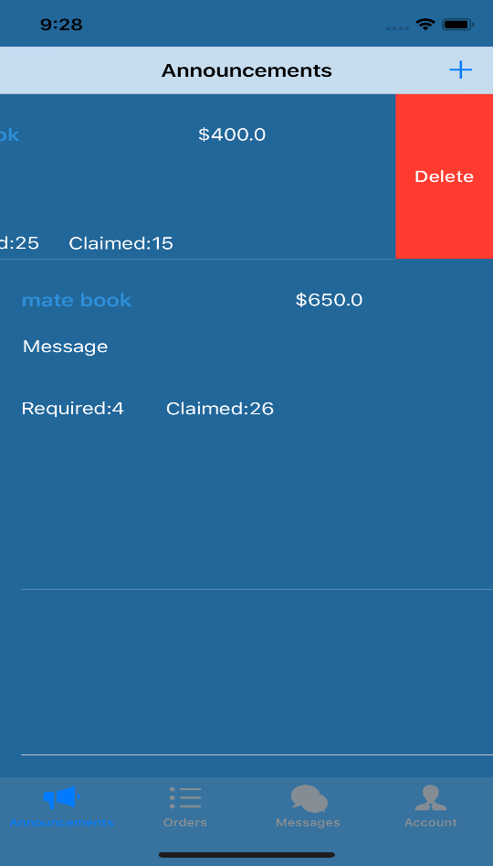
Update & Delete Announcements
Fig.13: Update Announcements View Fig.14: Delete Announcements View
Manogna Sivangula

Slide 22
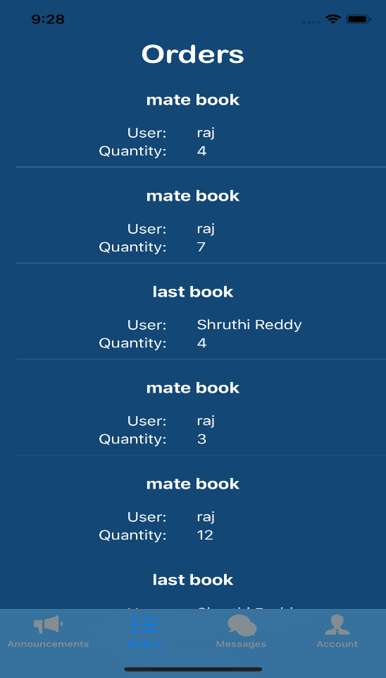
Admin - Orders
When Claims a products
An order is created for both users and admin.
By swiping an order admin can approve or reject the claim.
Fig.15: Admin orders view
Manogna Sivangula

Slide 23
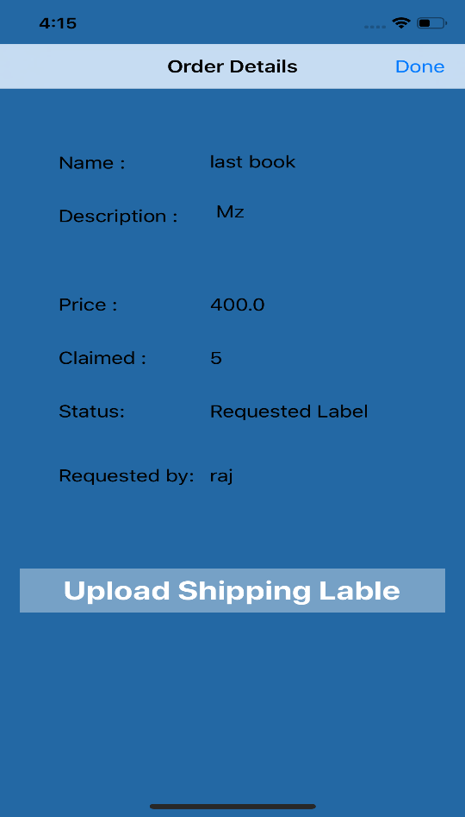
Upload Shipping label
After approving claim request
Admin can upload shipping label by selecting label from admin’s gallery.
Fig.16: Upload label view
Manogna Sivangula

Slide 24
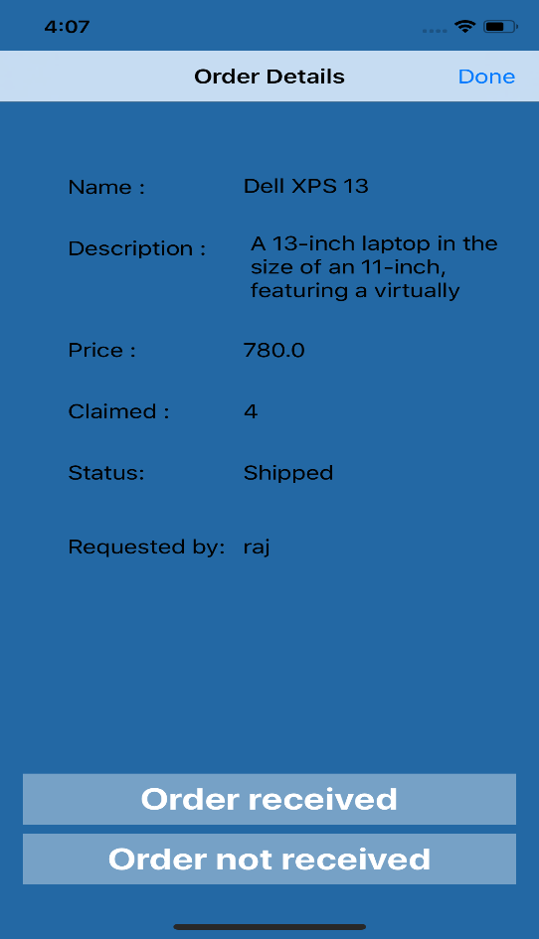
Order Received
After receiving order admin will update order status to order received.
Fig.17: Order Received view
Manogna Sivangula

Slide 25
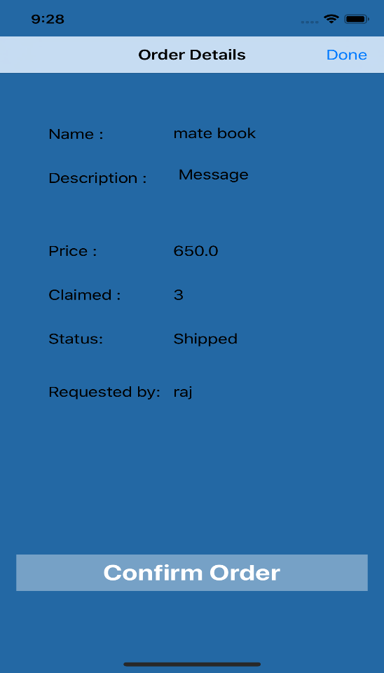
Confirm Order
After checking the products received, admin can update status to confirm order.
After this step user can be able to request for the payment.
Fig.18: orders detailed view
Manogna Sivangula

Slide 26
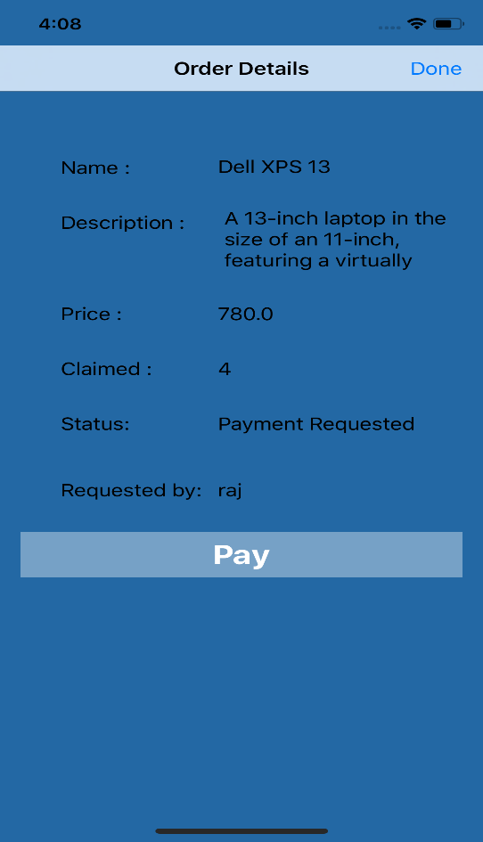
Record Payment
Payment details are recorded in the order by adding payee name and amount.
Fig.19: Record Payment view
Manogna Sivangula

Slide 27
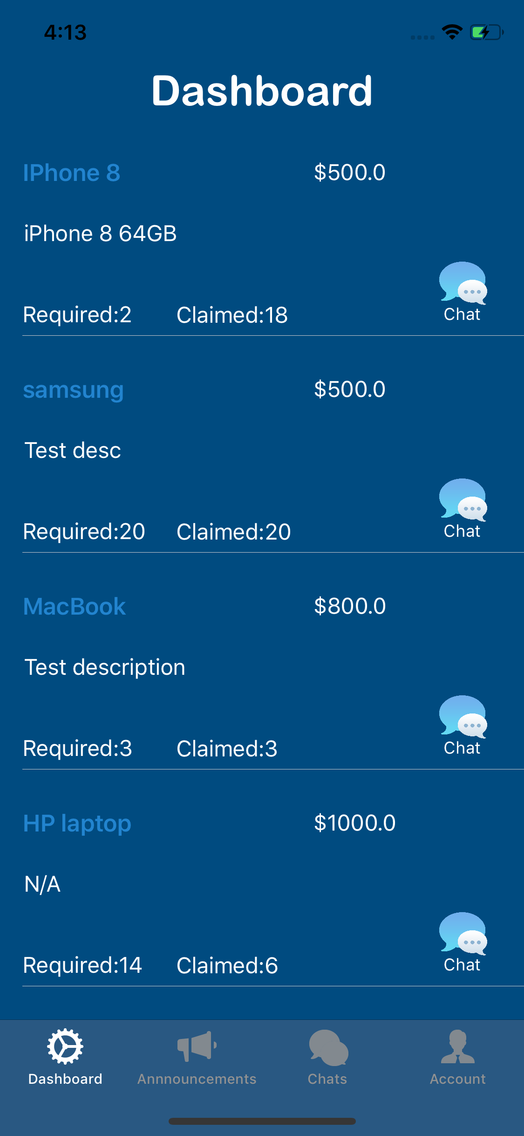
User - Dashboard
Displays all the announcements.
Contains
Item name,
Quantity required,
Image of the item,
Description of item.
Fig.20: Dashboard
Manogna Sivangula

Slide 28
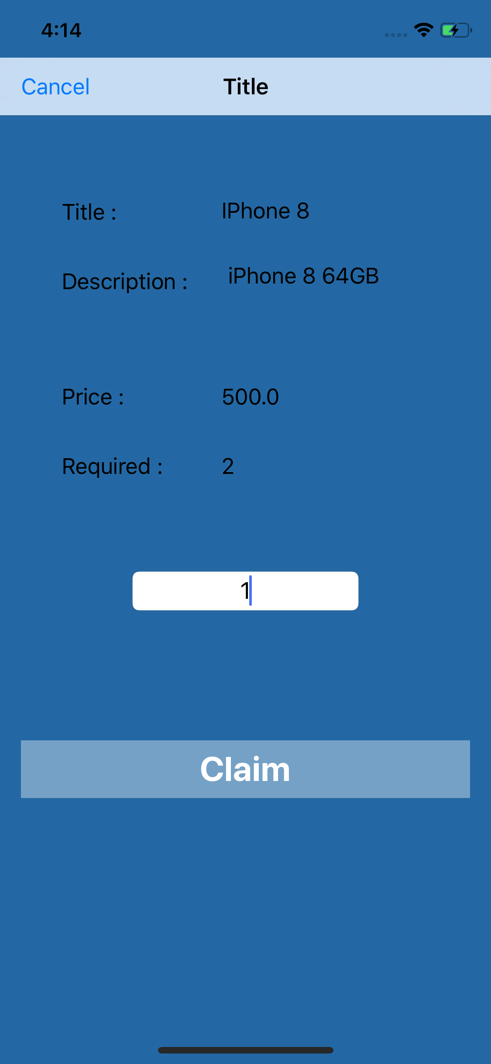
Product Details
When user selects a product
App redirects to product details view
User can view complete details of product
Have a claim button to claim the products.
Fig.21: Product detailed view
Manogna Sivangula

Slide 29
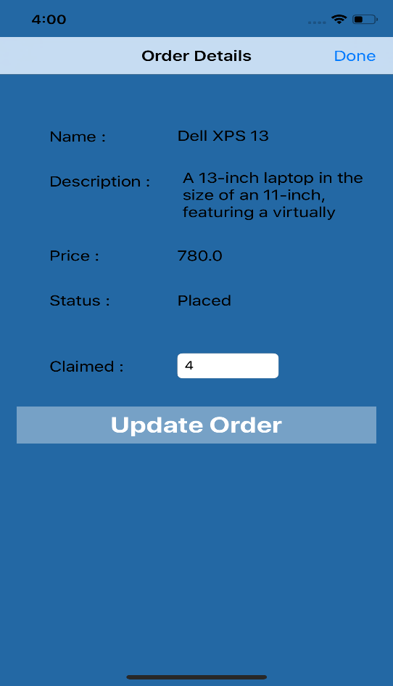
Update Claim
Before admin approve or reject request claim, User can update the claim.
After admin’s decision update claim button is disabled.
Fig.22: Update Claim products view
Shruthi Patlolla

Slide 30
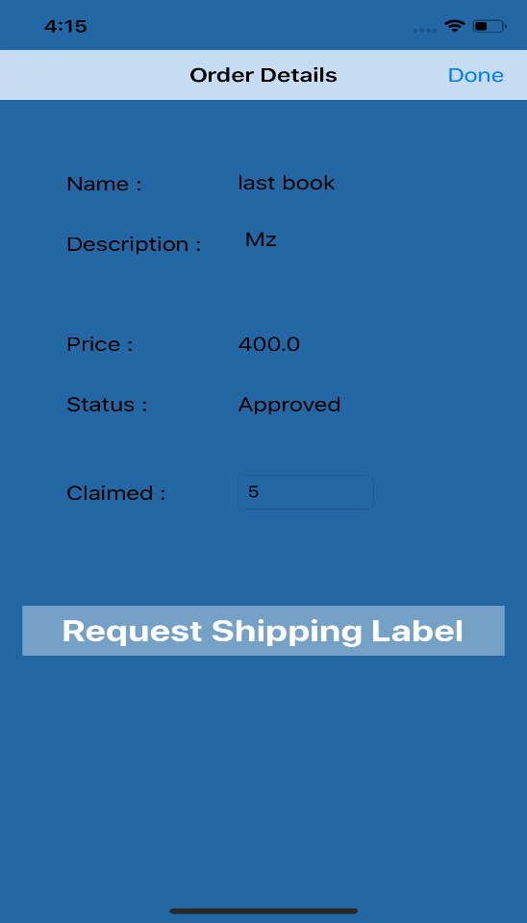
Request Shipping Label
After admin approves claim request, user can be able to see request shipping label.
Order status will be updated for both admin and user to “Requested shipping label”.
Fig.23: Request label view
Shruthi Patlolla

Slide 31
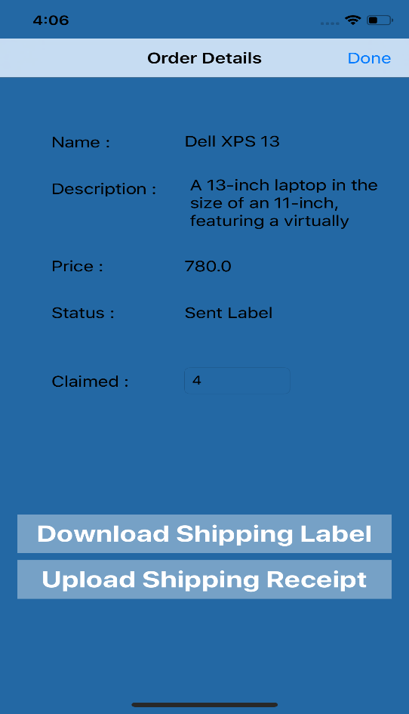
Download Shipping label
When admin uploads a label,
A “Download shipping label” is enabled for the user.
When he downloads the label it is directly saved to user’s gallery.
Fig.24: Download Label view
Shruthi Patlolla

Slide 32
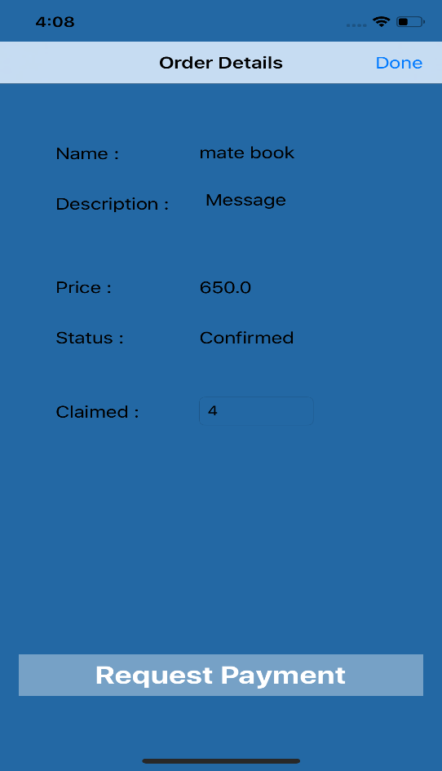
Request Payment
When admin updates order status to “Order received”
User can able to request for the payment.
An request is sent to admin
Fig.25: Request Payment view
Shruthi Patlolla

Slide 33
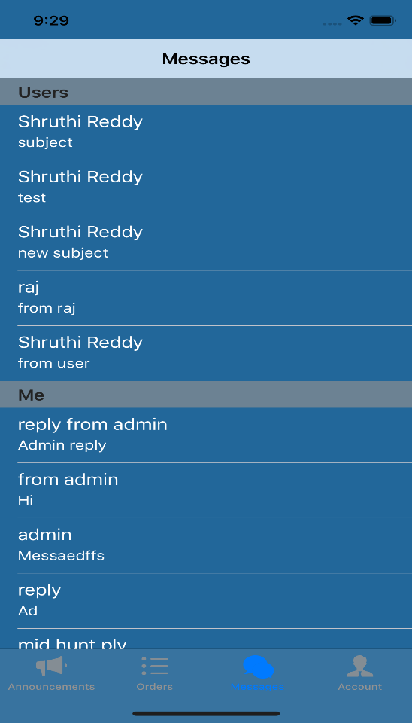
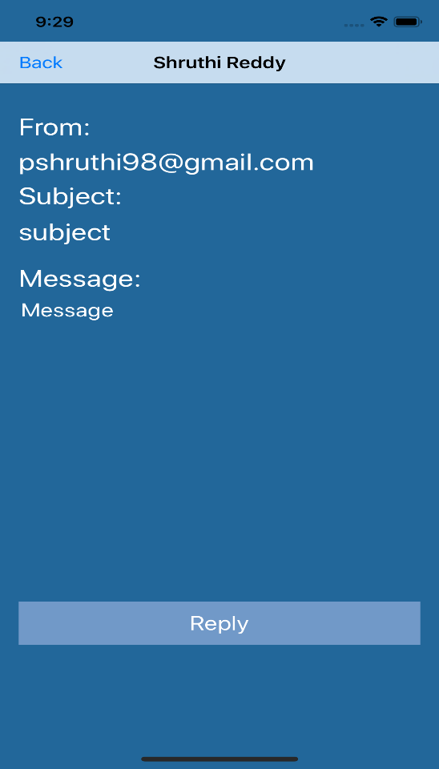
Messaging
Admin & user can send and receive messages directly using this app.
Fig.26: Messaging view Fig.27: Message view
Shruthi Patlolla

Slide 34

DataBase(BackendLess mBass)
mBaas(Mobile Backend as a Service)
Cloud storage.
Unified way of connecting to cloud services.
Unified API and SDK.
Supports multiple platforms.
Shruthi Patlolla

Slide 35
Connection to Backendless
Steps for connection establishment
Register to Backendless
Create an app
Connect our app to Backendless
- Embed API key of backendless app in “App Delegate”
4. Create Backendless instance
5. Perform CRUD operations
Shruthi Patlolla

Slide 36
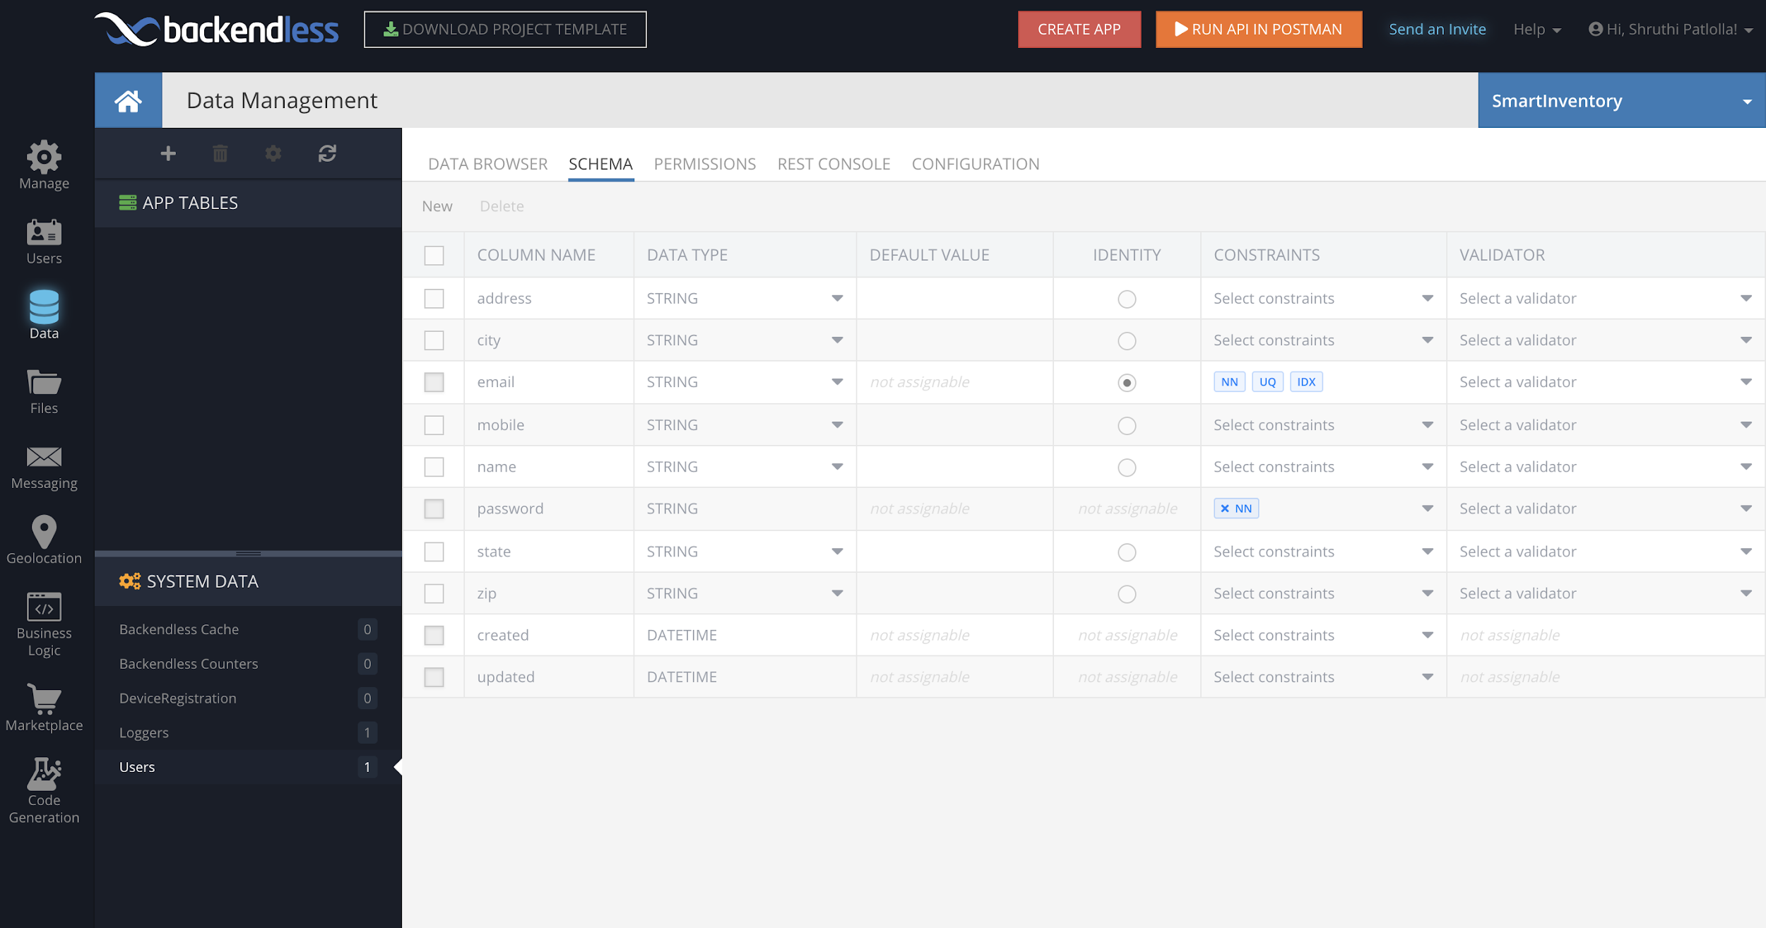
User Schema
Fig.14: User schema
Bharadwaj Dasari

Slide 37
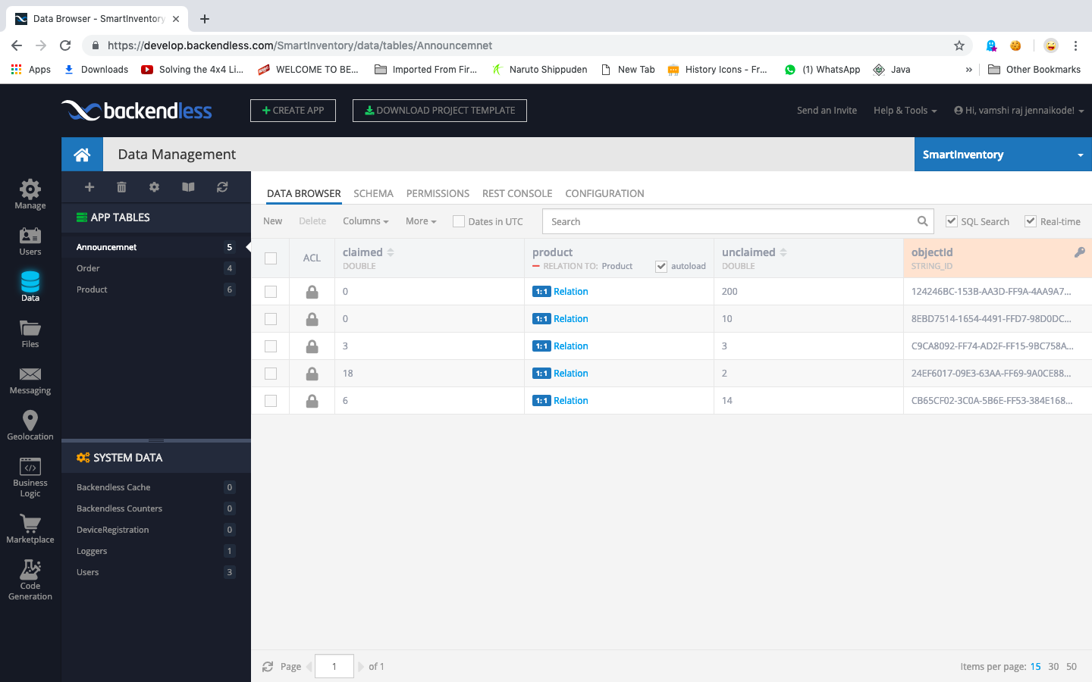
Announcement Schema
Fig.15: Announcement schema
Bharadwaj Dasari

Slide 38
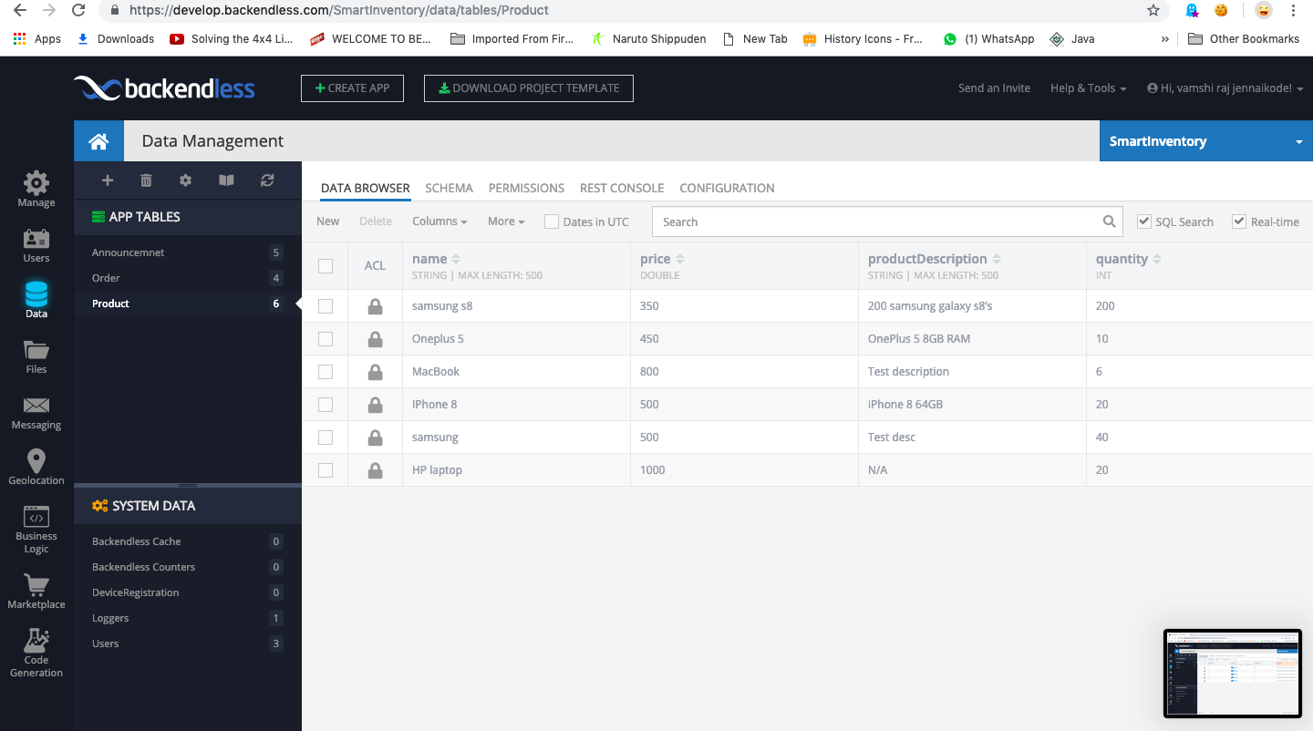
Product Schema
Fig.16: Product schema
Bharadwaj Dasari

Slide 39
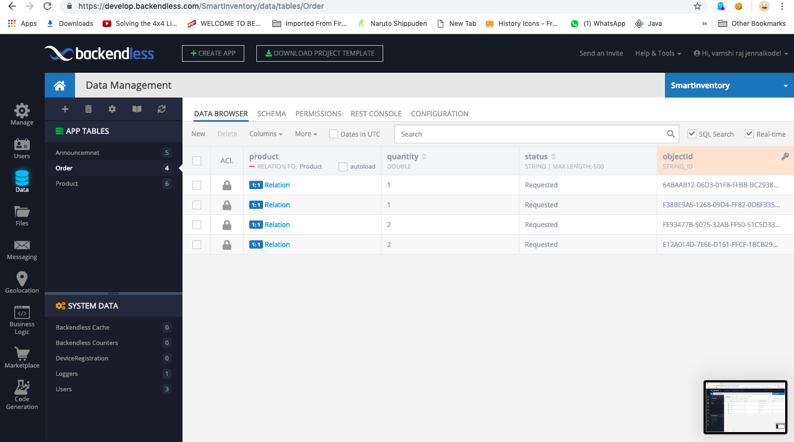
Orders Schema
Fig.17: Orders schema
Bharadwaj Dasari

Slide 40
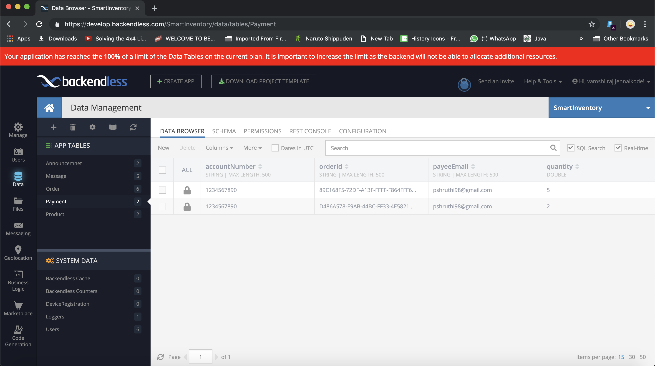
Payment Schema
Fig.17: Payment Schema
Bharadwaj Dasari

Slide 41
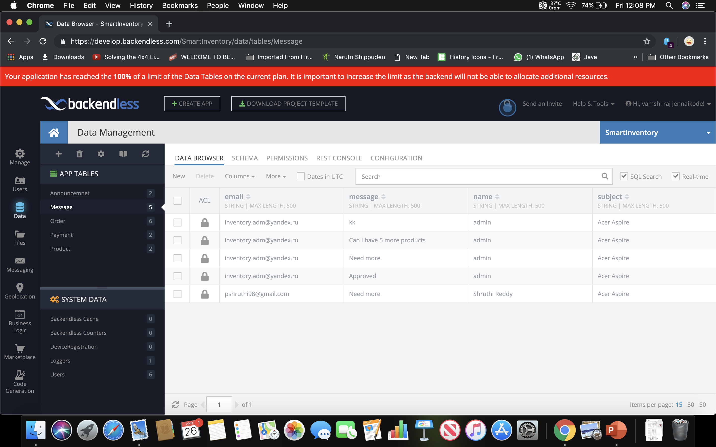
Messages Schema
Fig.17: Messages Schema
Bharadwaj Dasari

Slide 42

Tools and Technologies
Xcode
Xcode Emulator
Swift
BackendLess
Slack
Git
Agile
Bharadwaj Dasari

Slide 43
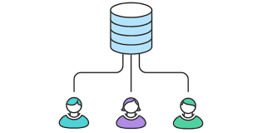
GIT
Version control system for tracking changes.
Supports teamwork.
Mainly used in distributed environments.
Aimed for speed and data integrity.
Supports non-linear development.
Github link: https://github.com/rajv11/SmartInventoryiOS
Bharadwaj Dasari

Slide 44
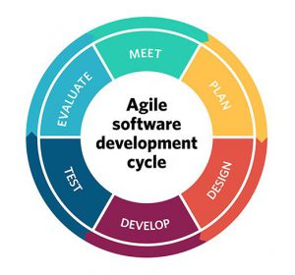
Agile
Planning flexibility
Shortened time cycles
Fewer bottlenecks
Visual metrics
Continuous Delivery
Bharadwaj Dasari

Slide 45
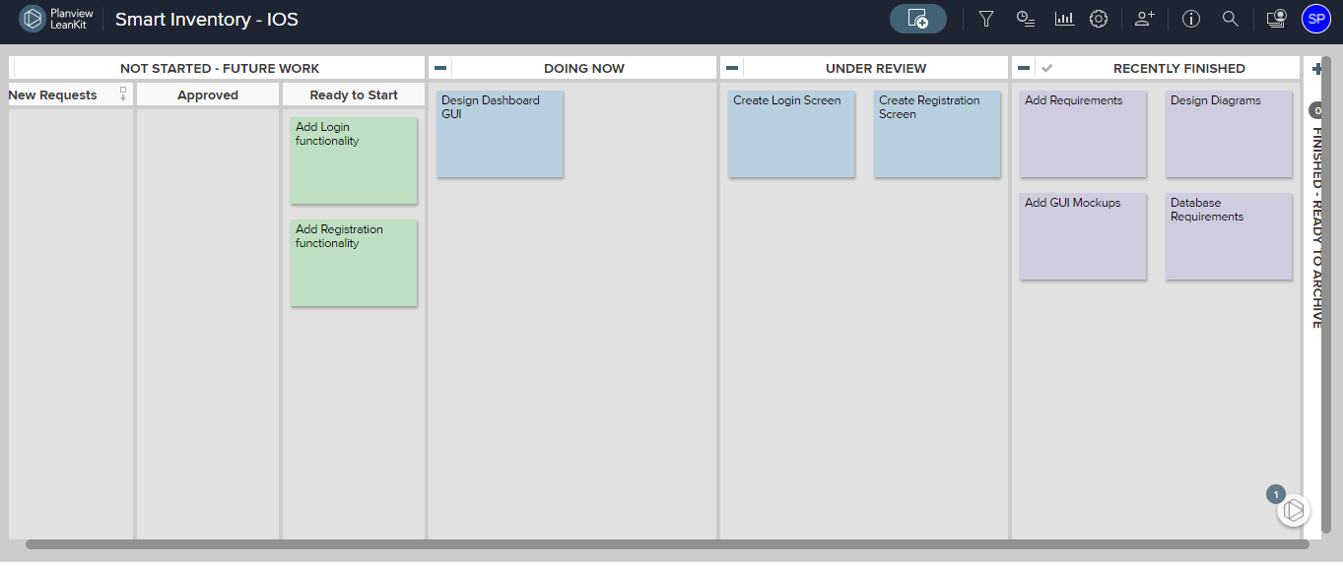
Agile
Fig.18: Kanban Board
Bharadwaj Dasari

Slide 46
Demo
Vamshi Raj Jennaikode

Slide 47
Project Contacts
Git
https://github.com/rajv11/SmartInventoryiOS
Team members contact
Team Member | Email Id | Contact number
Manogna Sivangula | S531505@nwmissouri.edu | 201973493
Shruthi Patlolla | S531376@nwmissouri.edu | 9378153014
Vamshi Raj Jennaikode | S531370@nwmissouri.edu | 6605280403
Midhun Kumar Kurapati | S531502@nwmissouri.edu | 6605280582
Naga Ravi Teja sai Mohan Vummidi | S531511@nwmissouri.edu | 6605280147
Bharadwaj Dasari | S531366@nwmissouri.edu | 6605280176

Slide 48
Questions ?

Slide 49
Thank You
Bharadwaj Dasari
Shruthi Patlolla
Sai Mohan Vummidi
Manogna Sivangula
Midhun Kumar Kurapati
Vamshi Raj Jennaikode

